Slide 1
Ceph: A Scalable, Unified Storage Solution

Slide 2

Outline
Introduction
Storage types
Applications
Pre-requisites
Minimum Hardware Requirement
Deployment Strategies
Deployed Framework
Ceph Read/Write Throughput
Addition/Removal of Ceph Nodes
Node Failure

Slide 3
What is Ceph ?
Ceph is designed to offer excellent scalability, making it suitable for large-scale deployments.
It provides outstanding performance and reliability, ensuring consistent and dependable storage solutions.
Ceph supports object, block, and file storage within a single system, commonly used in cloud computing environments.

Slide 4
Storage
Ceph provides 3 types of storage
Object Storage : Suitable for unstructured data like multimedia files, backups, and archives.
Block Storage:Provides block storage for virtual machines and databases.
File System Storage :For scenarios requiring shared access to file-based data, such as home directories and shared storage for applications.

Slide 5
Application
Cloud Storage: Efficient object storage with Ceph.
Virtualization: Integrate with platforms like OpenStack, Proxmox, and VMware for virtual machine block storage.
Data Analytics : Parallel processing of large datasets.
Backup and Disaster Recovery: Utilize Ceph's reliable, fault-tolerant architecture for backup .

Slide 6
Pre-requisites
Servers: Deploy Ceph on servers meeting its minimum hardware requirements.
Operating System: Use supported Linux distributions like CentOS, Ubuntu, or Debian.
Network Configuration: Connect servers to a reliable network with sufficient bandwidth and low latency.
Root Access: Ensure root access for installing and configuring Ceph.

Slide 7
Minimum Hardware Requirement
Operating System:Ubuntu Server 20.04 LTS or later
CPU Cores :4 >= cores per node
RAM :8 GB >= per node
Storage: Free block device /dev/sdb per node for Ceph storage
Network Connectivity: Stable network connection between nodes
Network Interfaces : 1 Ethernet interface for public network access and
1 Ethernet interface for cluster network communication

Slide 8
Deployment Strategies
Node Roles: Each node will act as an object storage, monitor daemon, and manager daemon for redundancy and fault tolerance.
Network Configuration: Set up a private cluster network (192.168.10.0/24) for Ceph communication and a public network for client access.

Slide 9
Deployed Framework - Architecture
Ceph Server | Public Network | Cluster Network Bond | Services | OSD | Storage (TB)
Ceph1 | 172.16.114.100 | 192.168.10.11 | MON,OSD,MDS | 4 | 14.4
Ceph2 | 172.16.114.205 | 192.168.10.12 | MON,OSD,MDS | 4 | 5.4
Ceph3 | 172.16.114.138 | 192.168.10.13 | MON,OSD,MDS | 3 | 1.1
Ceph4(VM) | 172.16.114.210 | NIL | MGR
Ceph5 | 172.16.114.98 | 192.168.10.14 | MON,OSD,MDS | 5 | 21.6
MON :- Monitor
OSD :- Object Storage
MDS :- Metadata Server
MGR :- Manager

Slide 10
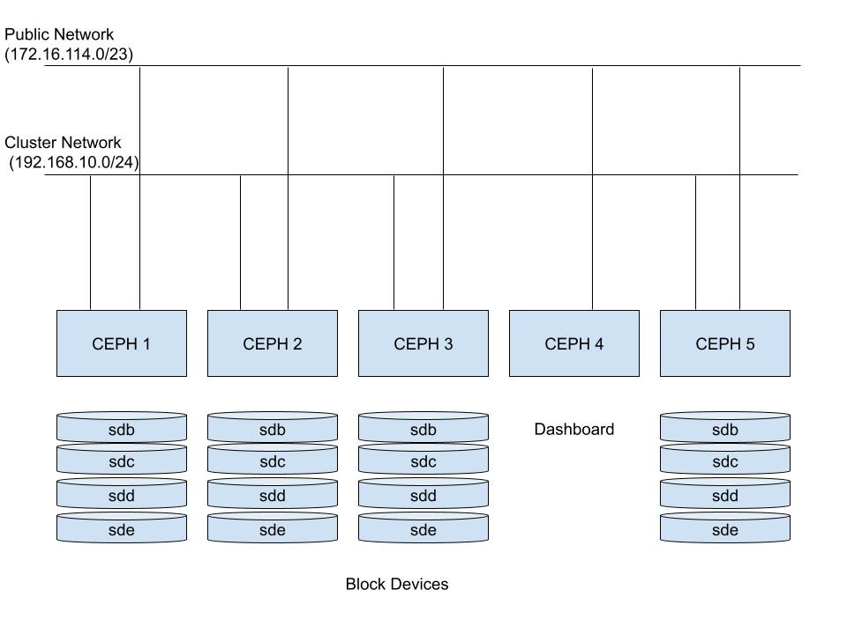
Deployed Framework - Architecture Diagram

Slide 11
Deployed Framework - Architecture Diagram Explanation
Ceph Server: Names or identifiers of the Ceph servers in the cluster.
Public Network: IP addresses for client access and external communication.
Cluster Network: IP addresses for inter-node communication, configured as a bond interface.
Services: Running services like MON, OSD, MDS, and MGR.
OSD: Number of Object Storage Daemons managing storage devices.
Storage (TB): Total storage capacity in terabytes of the OSDs on each server.
Ceph1: Public IP 172.16.114.100, Cluster IP 192.168.10.11, services MON, OSD, MDS, 4 OSDs, 14.4 TB storage.
Ceph2: Public IP 172.16.114.205, Cluster IP 192.168.10.12, services MON, OSD, MDS, 3 OSDs, 5.4 TB storage.
Ceph3: Public IP, Cluster IP, services MON, OSD, MDS, 3 OSDs, 1.1 TB storage.
Ceph4 (VM): Public IP, no Cluster IP, runs MGR service.
Ceph5: Public and Cluster IP, services MON, OSD, 5 OSDs, 21.6 TB storage.

Slide 12
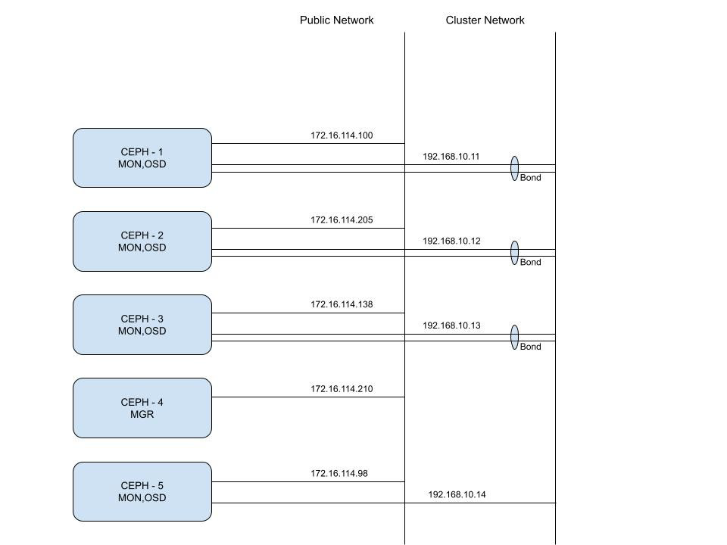
Deployed Framework-Network Diagram

Slide 13
Ceph Read/Write Throughput (Distributed)
Read:-20MB/second (Avg)
Write:- 40MB/second (Avg)

Slide 14
Add or Remove Monitor Nodes in Ceph Cluster
Before proceeding with the deployment, ensure you have the following
Access to servers with root privileges.
Connectivity between servers over SSH.
Servers running a supported Linux distribution (e.g., CentOS, Ubuntu).
Basic knowledge of Ceph architecture and concepts.

Slide 15
Add Nodes in Ceph Cluster
Install: Ensure Ceph packages are installed on the new node.
Configure: Append new node details to ceph.conf.
Deploy: Set up MON, OSD, MDS daemons using ceph-deploy.
Integrate: Execute cluster authentication and node integration commands.

Slide 16
Remove Nodes in Ceph Cluster
Decommission: Migrate data with ceph osd out <osd-id>.
Monitor: Watch data migration and rebalance with ceph -w.
Remove: Purge OSDs using ceph osd purge <osd-id>.
Cleanup: Remove node entries from ceph.conf and decommission services.

Slide 17
Node Failure
Automatic Data Redistribution: Ceph's CRUSH (Controlled Replication Under Scalable Hashing) algorithm redistributes data from failed nodes to other available nodes.
Data Replication: Ceph maintains multiple copies of data, ensuring availability even if one node goes down.
Recovery and Rebalancing: Ceph's OSDs detect node failures and initiate data recovery and rebalancing to maintain redundancy and performance.

Slide 18
Thank You

